Slide 1
WELCOME ICU Knowledge triangle, Innovation, Reinforcing of Education, Research, E-Health and Medical Links
Kick off meeting
10-11 February, 2020
October 6 City, Egypt
Mosad Zineldin and Valentina Vasicheva, LNU
And ICU team

Slide 2
WP1: University- Enterprise Centers of E-Health Innovations
WP2: University- Enterprise Web Platform
WP3: Professional Diploma & Master Study Modules
WP4: University- Enterprise In-service Training (IST)
WP5: Capacity Building (CB)
WP6: Dissemination
WP7: Sustainability
WP8: Quality Control (QC)
WP9: Management
+ AZHU

Slide 3
WP1. PREPARATION
WP1: University-Enterprise (UE) Centers of e-Healht innovation (CeHI) as the most important preparation phase for conducting the rest of the porjct activities
1.1 Defined requirements for CeHI centers 2020
1.2 Established CeHI centers 2020
1.3 Verified CeHI 2021
1.4 Launched consultancy services 2021-2022
The survey has be done. The answers are analysed, gaps are identified and recommendations are provided.
The reports are available in Box.

Slide 4
WP2. University -Enterprise Web platform KTERE starts : 2021
2.1 Defined requirements for web platform KTERE
2.2 Established web platform KTERE
2.3 Launched web platform KTERE and integrated with the other existing e-services

Slide 5
WP3. Study courses and professional Diploma Programs
3.1 Established reference Team and defined programme requirements
3.2 Designed course curriculum
3.3 Verified curriculum 2021
3.4 ECTS grading scale & diploma Supplement 2021 -2022
To be done:
Designed course curriculum | Study of state of art of the existing Curriculum at Partners Universiti es , Individuation of the gaps to be filled Individuation of the steps to be done | Name and description of existing Curriculum
Verified curriculum | Individuation of best course for partner countries Adaptation of the course for North Africa reality | Course design Course held , Course accreditation
ECTS grading scale & diploma Supplement | Individuation of the weight of each modules insight the course curricula and assignment of the ECTS | ECTS for each module

Slide 6
WP4:In-service training
Starts Year 2
4.1 Defined programme requirements
4.2 Designed in-service modules
4.3 Launched in-service modules
4.4 Verified in-service modules
Training by TalTech - November 2020 – appr.100 participants

Slide 7
WP5: Capacity Building
5.1 Established local teams
5.2 Completed English courses
5.3 Capacities built for all involved groups
Training by TalTech - November 2020 – appr.100 participants
Local teams are defined
5.1 : established local teams : Completed (i hope all partners were able to send to professor mosad their nominations)
5.2 : English courses training: MUBS is currently preparing a placement test + syllabi of 3 English courses (Deadline December 10, 2020). The training will be conducted at partner institutions during the first quarter of 2021.
5.3: Capacities built for all involved groups : Ongoing (you can refer here to the Taltech training in which we involved stakeholders to increase the visibility and impact of the project + planned Cesie training...)
Training by TalTech - November 2020 – appr.100 participants
Local teams are defined

Slide 8
WP6: Dissemination
6.1 Guidelines dissemination/strategy defination
6.2 Webportal, sharepoint, electronic means and Graphical Dissemination Suite
6.3 Arranged internal and external dissemination actions & networking with stakeholders
6.4 Social media and media covers
6.5 Publications, newsletters
FOCUS of OUR dissemination plan and Implementation (you can find it on BOX and Website) is on:
raise awareness;
extend the impact;
engage stakeholders and target groups;
share solutions and know how;
influence policy and practice;
develop new partnerships.

Slide 9
Some implementation of the Dissemination
1-project website https://www.icurere.com 2-Share to on the website the Facebook-ENSTN –LinkedIn -Academia -Twitter Example link : https://egyneosafety.net/third-newsletter-about-corona-virus-nl-no-3-2020-from-project-icu/ https://egyneosafety.net/e-health-training-program-taltech-estonia-13th-november-2020/ https://egyneosafety.net/our-new-project/ https://www.linkedin.com/events/6729065685558808577/ https://www.facebook.com/events/3393870490709079/ https://twitter.com/home https://www.academia.edu/44420076/ERASMUS_Capacity_building_project https://99nicu.org/calendar/event/248-e-health-training-program-taltech-estonia-13th-november-2020/ https://99nicu.org/calendar/event/249-research-variables/ https://cesie.org/en/higher-education-and-research/rere-ehealth-research-innovation/ https://www.mubs.edu.lb/oia/news/5529.aspx https://www.taltech.ee/health-care-technology https://ac15f990-1e47-4d47-beda-3519e1823f72.filesusr.com/ugd/23fe5d_f7f0c97be1a34bd0a8a8a6b06e4dd9a4.pdf

Slide 10
Con. Some implementation of the Dissemination
-Family messages word files
2- Family messages YouTube
3-project wesite
4-https://www.icurere.com/
5-https://ac15f990-1e47-4d47-beda-3519e1823f72.filesusr.com/ugd/b7e8de_d4499179a2a547ecbcf947eb618a70ec.pdf
6-https://lnu.se/en/meet-linnaeus-university/contact-and-visit-us/crisis-and-security/corona/
7-TalTech e.medicine Centre
https://youtu.be/gS-3Z41FsJs
https://www.facebook.com/cesie.ngo/posts/10163132308730557
https://www.facebook.com/cesie.ngo/posts/10164107570785557

Slide 11
WP7: Sustainability Starts at YEAR 2
7.1 Approval of the modules and diploma
7.2 Launched in-service training by CeHI
7.3 Core Fundraising & Analytics Teams
7.4 Inter-regional association “CeHI”

Slide 12
WP8: Quality Control
8.1 Established Quality Control Group
8.2 Project contingency plan
8.3 Implemented internal QC procedures
8.4 Implemented external QC procedures
8.5 Completed inter-project coaching
Quality control grouped is established
Quality evaluation of activities and meetings are conducted
Project contingency plan was discussed and agreed upon at the kick off meeting. The updates to the plan are made regularly according to circumstances
After each conducted activity the survey is distributed to the participants and the answers are summarized.

Slide 14
WP9: Management
9.1 Kick-off meeting
9.2 Project Plan
9.3 Consortium agreement
9.4 Coordination meetings
9.5 Project reports to EC
Kick off was hold in Beirut in March 2020
All documentation is available in Box and is open to all partners
Coordination meetings are held online
Minutes of the minutes are available in Box
Contigency plan is available and updated regularly according to circumstances

Slide 15
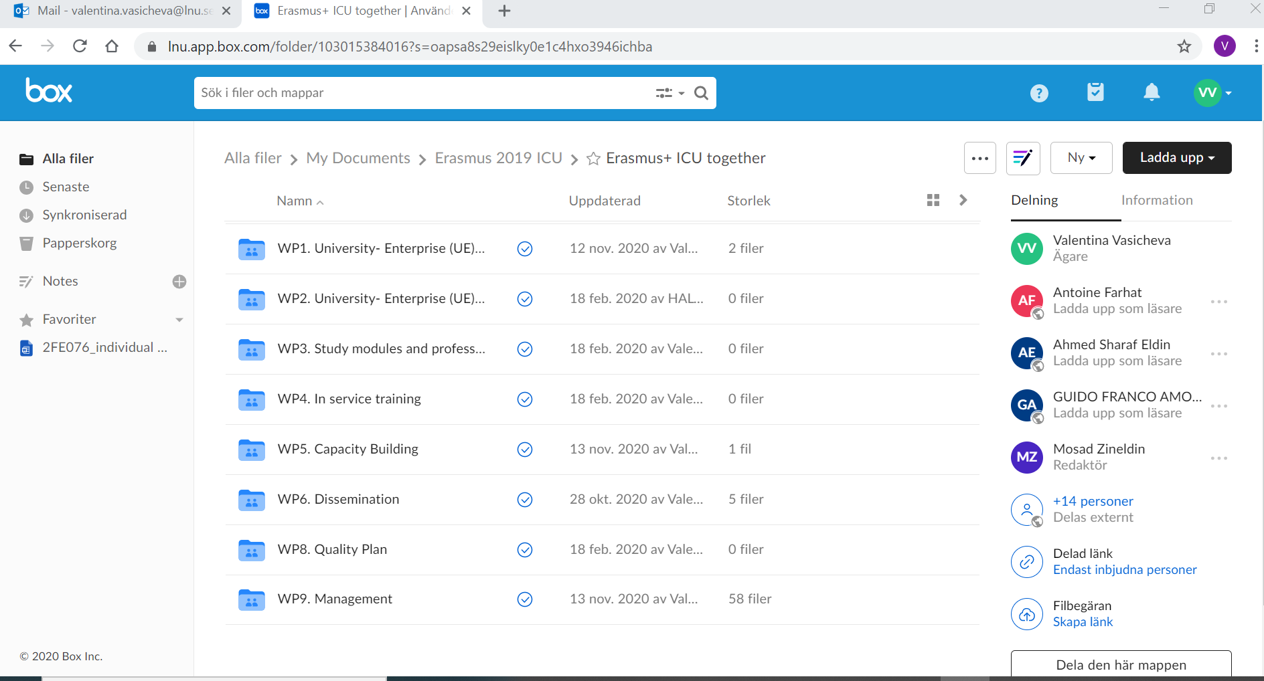
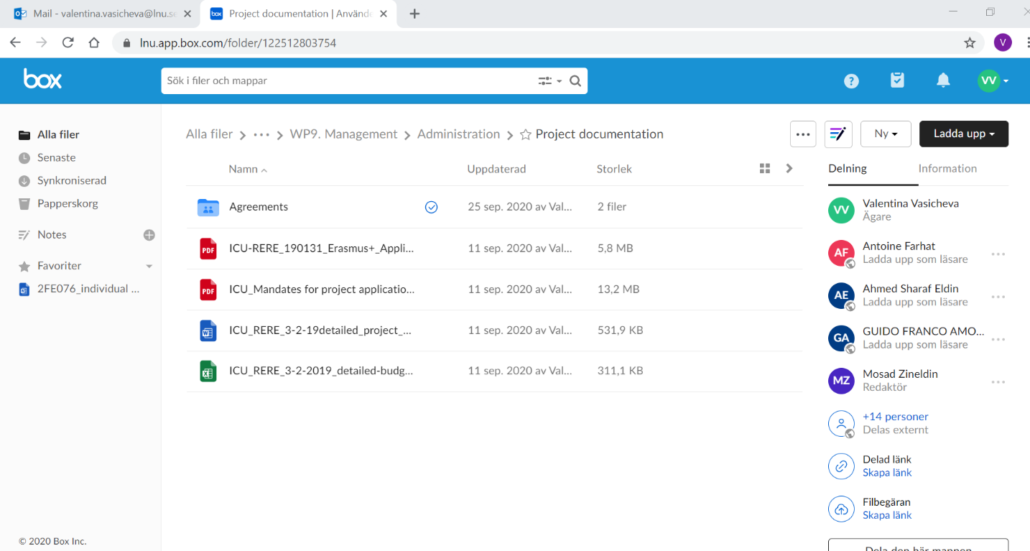

Slide 16
